Slide 1


AUTOMATIC FLOOD MONITORING , WARNING AND CONTROLLING SYSTEM FOR SUBWAYS AND UNDERPASSES
TEAM MATES :
SRIRAM R ,
VALLARASAN G,
VISHNU PRAKASH P.
IV YEAR ECE - B
GUIDE :
Mr. S.SATHYA MOORTHY M.E.,
Assistant Professor & HOD / ECE
MRK INSTITUTE OF TECHNOLOGY
KATTUMANNARKOIL , CUDDALORE – 608 301.

Slide 2
PROBLEM STATEMENT
During the Rainy season the subways and underpasses were affected by the flood water , This was caused by civil and constructional error , So how to reduce and prevent the error ?

Slide 3
ABSTRACT
Flood is one of the natural disasters that cannot be avoided. It happens too fast and affected so many lives and properties. Before this, most of the existing system that has been developed are only focus on certain areas. Other than that, majority of the public cannot monitor and have no idea when the flood going to be happened since they do not have any information and data about the weather condition. By having our proposed system , this will solve all the drawbacks of the existing system. The proposed system is suitable for subways and underpasses. Furthermore, the Government officials can monitor what is happening and predict if there is any upcoming flood at the web server. The proposed system is a low cost in design and easy for maintenance. This project will update the water level at the web server and the system will display the risk level then issue alert signal , finallay control by blocking the roads and disposing the flood water by motors to the citizens for evacuation so that fast necessary actions can be taken.
KEYWORDS : Flood , IoT , Public issue , Sensors , Actuators , Arduino UNO.

Slide 4
OBJECTIVES
1. To design a flood detection and control system that will detect and send the real time information about the flood to the local Government Unit.
2. To generate the database related to water level, water flow, rainfall and its processing using the IoT Cloud server.
3. To design a webpage with a user-friendly interface that will collect the data from cloud server and display the alert of flood and control by using actutors.

Slide 5
INTRODUCTION
Flooding in subways and underpasses poses a significant risk to public safety, infrastructure, and transportation systems. Sudden heavy rainfall, poor drainage, and rising water levels can lead to accidents, vehicle damage, and traffic disruptions. To mitigate these risks, an Automatic Flood Monitoring, Warning, and Controlling System is essential for detecting water levels, alerting authorities and commuters, and activating flood prevention mechanisms.
This project leverages Embedded Systems, IoT, and Mechatronics to design an intelligent flood management solution using Arduino UNO or NodeMCU. Integrating real-time monitoring, automated control, and remote notification capabilities. this system enhances safety and prevents flood-related accidents in subways and underpasses. It serves as a reliable and cost-effective solution for urban flood management, ensuring efficient response and minimizing potential damage.

Slide 6
LITERATURE SURVEY
S.No | AUTHOR NAME | TITLE | YEAR OF PUBLISHED | REMARKS
1. | Gade Yash Dilip, Bhoye Sanjay Vijay, Gandole Avinash Dnyaneshwar, Prof. Rathod G. G | IOT BASED FLOOD MONITORING AND ALARM SYSTEM | 2024 | The purpose of this project is to sense the water level in river beds and check if they are in normal condition.
2. | Chitimireddy Nirusha , Goutam Kumar , Sharaff Dhanvanthri , S.M. Saira Banu Basavaraj.H | FLOOD MONITORING AND EARLY WARNING SYSTEM USING RASPBERRY PI | 2023 | Raspberry pi, GSM Module, DHT11 sensor, Water Flow sensor, Rain sensor, Moisture sensor, PCB, Ultra-sonic sensor, Light, Buzzer
3. | Mr. J. Rajanikanth, M.Tech(Ph.D)1, Bandi Saahithi2, Dorigundla Sreelatha Reddy3, | IoT BASED FLOOD MONITORING AND ALERTING SYSTEM | 2023 | Arduino Mega, DHT11 Sensor, GSM Module, ThingSpeak Web Application, Battery.
4. | Kiran Jadhav*1, Aniket Patil*2, Ajay Yamkar*3, Mrunmai Nagtode*4 | IOT BASED FLOOD MONITORING AND ALERTING SYSTEM | 2022 | Wi-Fi, Flooding, Water Level, Monitor, Emergency Alerts, Arduino, Email Alerts, Sensors.
5. | Mr. Bhushan M. Borhade1, ,Miss. Kajal G. Date2, Miss. Pooja U. Kahane3, Miss. Rutuja B. Rasal4,, Miss. Komal S. Aher5, | FLOOD DETECTION AND WATER MONITORING SYSTEM USING IOT BASED ON DISASTER MANAGEMENT SYSTEM | 2021 | Disaster management system, Sensors, microcontrollers, Flood
6. | 1GUMMA SREE KARUN, 2BYRENI SUDHARSHAN, 3R RAMA RAO, 4B L MOHAN | DEVELOPMENT OF SMART FLOOD MONITORING SYSTEM USING ULTRASONIC SENSOR WITH BLYNK APPLICATION | 2019 | This paper presents the development of a smart flood monitoring system using Blynk platform as a medium of data transmission.

Slide 7
EXISTING SYSTEM
In Existing system of the project is flood monitoring and warning system was only implemented and automated . is no innovations were designed for the particular location of flooded area.
Manual Inspection – Authorities or maintenance teams physically inspect water levels in subways and underpasses.
CCTV Surveillance – Cameras are used for visual monitoring, but they require constant human supervision.
Basic Water Level Alarms – Some locations use simple float switches or water level sensors to trigger alarms.
Drainage Systems – Water pumps are activated manually or based on basic automated systems with limited.

Slide 8
Demerits of the Existing System
Lack of Real-Time Monitoring.
Limited Automation.
No Remote Notification.
Inefficient Traffic Control.
High Response Time .
Unreliable Drainage Activation.
High Maintenance.

Slide 9
PROPOSED SYSTEM
This project integrates Mechatronics and IoT to develop an Automatic Flood Monitoring, Warning, and Controlling System for subways and underpasses. By utilizing sensors, microcontrollers (Arduino UNO or NodeMCU), and IoT platforms, the system continuously monitors water levels and categorizes risk into three levels based on vehicle entry restrictions. Alerts are displayed via LED indicators, LCD/OLED screens, and IoT dashboards for real-time monitoring by authorities. If water levels rise critically, pumps are activated for drainage, alarms and warning lights alert commuters, and servo motors close entry points to prevent accidents. This smart system enhances safety, automation, and remote monitoring, ensuring efficient flood management.

Slide 10
Merits of the Proposed System
Real-Time Monitoring.
Automated Risk Categorization .
Instant Alerts & Notifications .
Remote Monitoring & Control .
Efficient Flood Management .
Traffic Safety & Control .
Energy & Cost Efficiency .
User-Friendly & Scalable .

Slide 11
HARDWARE REQUIREMENTS
Arduino UNO.
Water level sensor.
Ultrasonic sensor.
Water flow sensor.
Rain sensor.
Wifi / IoT module (ESP8266).
Dc motors (water pump).
Level indicating LED.
LED (Danger Light).
Buzzer .
LCD or OLED.
Relay module.
Power adaptor.

Slide 12
SOFTWARE REQUIREMENTS
ARDUINO IDE ( Software).
EMBEDDED C ( Programming Language ).
Blynk or Thingspeak (Appview).

Slide 13
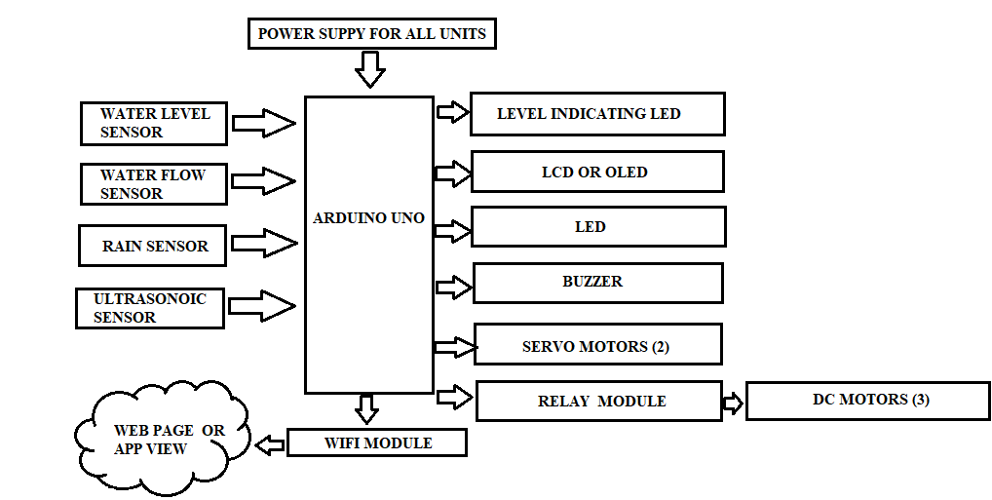
BLOCK DIAGRAM

Slide 14
BLOCK DIAGRAM DESCRIPTION
Arduino UNO – A microcontroller board that processes sensor data and controls connected devices in an embedded system.
Water Level Sensor – Detects water levels in subways and underpasses, helping to monitor flood conditions.
Ultrasonic Sensor – Uses sound waves to measure distance, commonly used to detect water levels accurately.
Water Flow Sensor – Measures the rate of water flow in a drainage system to monitor and control water movement.
Rain Sensor – Detects rainfall and helps in early flood prediction by triggering warnings.
WiFi/IoT Module (ESP8266) – Enables the system to send real-time data to a webpage or mobile app for remote monitoring.

Slide 15
DC Motors (Water Pump) – Pumps out excess water from flooded areas to prevent further accumulation.
Level Indicating LED – Shows different flood levels using LED indicators (e.g., green, yellow, and red for low, medium, and high levels).
LED (Danger Light) – A warning light that turns on when water levels reach dangerous levels, alerting commuters.
Buzzer – Produces a loud sound when flooding is detected to warn people and authorities.
LCD or OLED – Displays real-time information about water levels, alerts, and system status.
Relay Module – Acts as a switch to control high-power devices like pumps and traffic barriers based on sensor input.
Power Adapter – Supplies electrical power to the entire system, ensuring continuous operation.

Slide 16
APPLICATIONS
Subways and Underpasses.
Urban Drainage Systems Highways and Low-Lying Roads .
Smart Cities and IoT-Based Flood Management .
Railway Underpasses.
Residential and Commercial Flood-Prone Areas.
Industrial Areas.
Disaster Management Systems.

Slide 17
CONCLUSION
The Automatic Flood Monitoring, Warning, and Controlling System for Subways and Underpasses is a smart and efficient solution for managing urban flooding. By integrating Mechatronics, IoT, and Embedded Systems, this project enables real-time monitoring, warning, and automated flood control using Arduino UNO or NodeMCU along with various sensors.The system categorizes flood levels into three risk levels and provides instant alerts through LED indicators, buzzers, LCD/OLED displays, and IoT platforms. It ensures public safety by restricting vehicle entry in high-risk areas using servo motor controlled barriers and activates water pumps to drain excess water efficiently. With its automation, remote monitoring, and quick response capabilities, this project significantly enhances flood management in subways, underpasses, highways, and urban drainage systems. It serves as a cost-effective and scalable solution for smart cities, reducing flood-related accidents and infrastructure damage.

Slide 18
FUTURE ENHANCEMENT
Incorporating these advanced technologies will significantly enhance the Automatic Flood Monitoring, Warning, and Controlling System for Subways and Underpasses, making it more efficient, accurate, and scalable. By integrating AI, IoT, smart traffic management, and self-sustaining power solutions, the system can provide real-time monitoring, early warnings, and automated flood control. These future enhancements will improve public safety, disaster management, and urban flood resilience, making cities smarter and more responsive to extreme weather conditions.

Slide 19
REFERENCES
[1]. Zahir, Shahirah Binti, et al. "Smart IoT Flood Monitoring System." Journal of Physics: Conference Series. Vol.1339. No.1. IOP Publishing, 2019.
[2]. Priya, S. Jana, et al. "Flood monitoring and alerting system." International Journal of Computer Engineering &Technology (IJCET) 8.2 (2017): 15.
[3]. Hughes, Danny, et al. "An intelligent and adaptable grid-based flood monitoring and warning system.“ Proceedings of the UK eScience All Hands Meeting. Vol. 10. 2006.
[4] Gade Yash Dilip, Bhoye Sanjay Vijay, Gandole Avinash Dnyaneshwar, Prof. Rathod G. GInternational Journal of Advanced Research in Science, Communication and Technology (IJARSCT), Volume 4, Issue 2, February 2024 “IoT Based Flood Monitoring and Alarm System”.

Slide 20
THANK YOU TO ALL

